Slide 1
CS2422 Assembly Language & System Programming
November 27, 2003

Slide 2
Today’s Topic
Assembler: Machine Dependent Features
  SIC/XE
  Program Relocation
  Modification Records in an Object File.

Slide 3
Study Guide
Sections 2.2 (especially 2.2.2) of Beck’s “System Software” book.
  Section 2.2: Program Relocation

Slide 4
SIC/XE Assembler
We have learned the 2-pass assembler for SIC.
What’s new for SIC/XE?
  More addressing modes.
  Program Relocation.

Slide 5
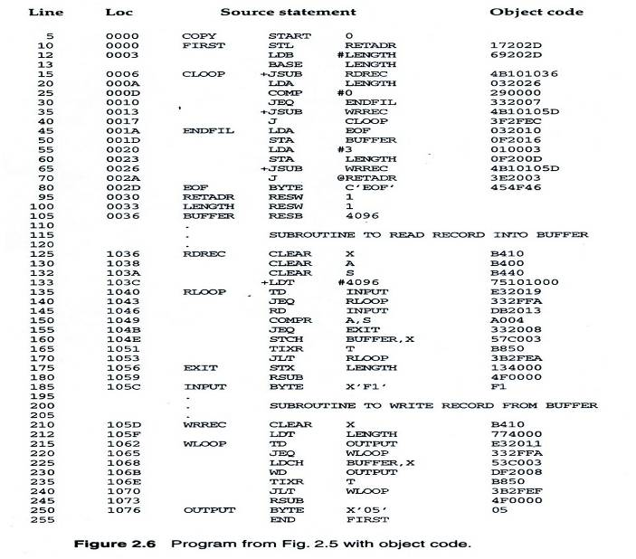
An SIC/XE Example Fig. 2.6

Slide 6
A Case of Object Code Generation
Figure 2.6, Line 10
    STL RETADR → 17 20 2D
The mode bit p=1, meaning PC relative addressing mode.
6 bits
12 bits
OPCODE
n
i
x
b
p
e
Address
0001 01
1
1
0
0
1
0
0000 0010 1101
17
20
2D

Slide 7
Instruction Format and Addressing Mode
SIC/XE
  PC-relative or Base-relative addressing: op m
  Indirect addressing: op @m
  Immediate addressing: op #c
  Extended format: +op m
  Index addressing: op m,x
  register-to-register instructions
  larger memory -> multi-programming (program allocation)

Slide 8
Translation
Register translation
  Register name (A, X, L, B, S, T, F, PC, SW) and their values (0,1, 2, 3, 4, 5, 6, 8, 9)
  Preloaded in SYMTAB
Address translation
  Most register-memory instructions use program counter relative or base relative addressing
  Format 3: 12-bit address field
    Base-relative: 0~4095
    PC-relative: -2048~2047
  Format 4: 20-bit address field

Slide 9
PC-Relative Addressing Mode
PC-relative
  10 0000 FIRST STL RETADR 17202D
    Displacement= RETADR - PC = 30-3 = 2D
  40 0017 J CLOOP 3F2FEC
    Displacement= CLOOP-PC= 6 - 1A= -14= FEC
OPCODE
n
i
x
b
p
e
Address
0001 01
1
1
0
0
1
0
(02D)₁₆
OPCODE
n
i
x
b
p
e
Address
0011 11
1
1
0
0
1
0
(FEC)₁₆

Slide 10
Base-Relative Addressing Modes
Base-relative
  Base register is under the control of the programmer
  12 LDB #LENGTH
  13 BASE LENGTH
  160 104E STCH BUFFER, X 57C003
    Displacement= BUFFER - B = 0036 - 0033 = 3
  NOBASE is used to inform the assembler that the contents of the base register no longer be relied upon for addressing
OPCODE
n
i
x
b
p
e
Address
0101 01
1
1
1
1
0
0
(003)₁₆

Slide 11
Immediate Address Translation (1/2)
Immediate addressing
  55 0020 LDA #3 010003
  133 103C +LDT #4096 75101000
OPCODE
n
i
x
b
p
e
Address
0000 00
0
1
0
0
0
0
(003)₁₆
OPCODE
n
i
x
b
p
e
Address
0111 01
0
1
0
0
0
1
(01000)₁₆

Slide 12
Immediate Address Translation (2/2)
Immediate addressing
  12 0003 LDB #LENGTH 69202D
  12 0003 LDB #LENGTH 690033
    The immediate operand is the symbol LENGTH
    The address of this symbol LENGTH is loaded into register B
    LENGTH=0033=PC+displacement=0006+02D
    If immediate mode is specified, the target address becomes the operand
OPCODE
n
i
x
b
p
e
Address
0110 10
0
1
0
0
1
0
(02D)₁₆
OPCODE
n
i
x
b
p
e
Address
0110 10
0
1
0
0
0
0
(033)₁₆

Slide 13
Indirect Address Translation
Indirect addressing
  Target addressing is computed as usual (PC-relative or BASE-relative)
  Only the n bit is set to 1
  70 002A J @RETADR 3E2003
    TA=RETADR=0030
    TA=(PC)+disp=002D+0003
OPCODE
n
i
x
b
p
e
Address
0011 11
1
0
0
0
1
0
(003)₁₆

Slide 14
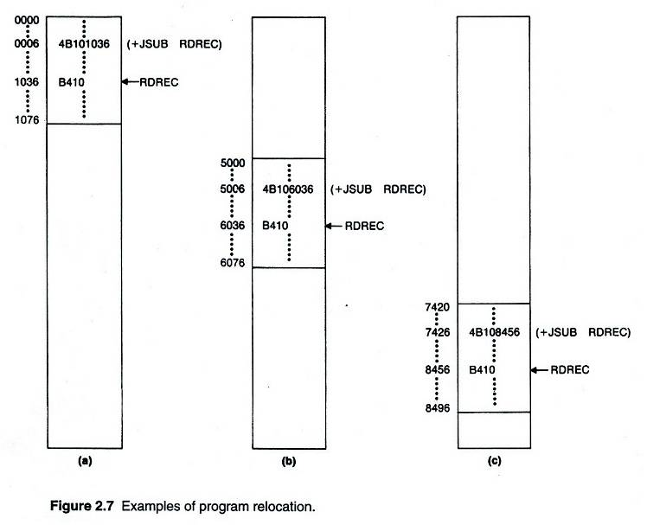
Program Relocation

Slide 15
Examples of Program Relocation (1/2)
Example Fig. 2.2
  Absolute program, starting address 1000
==== → 2000
5 2000 1000 COPY START 1000
10 2000 1000 FIRST STL RETADR 141033 142033
15 2003 1003 CLOOP JSUB RDREC 482039 483039
20 2006 1006 LDA LENGTH 001036 002036
25 2009 1009 COMP ZERO 281030 282030
30 200C 100C JEQ ENDFIL 301015 302015
35 200F 100F JSUB WREC 482061 483061
40 2012 1012 J CLOOP 3C1003 3C2003
45 2015 1015 ENDFIL LDA EOF 00102A 00202A
50 2018 1018 STA BUFFER 0C1039 0C2039
55 201B 101B LDA THREE 00102D 00202D
60 201E 101E STA LENGTH 0C1036 0C2036
65 2021 1021 JSUB WREC 482061 483061
70 2024 1024 LDL RETADR 081033 082033
75 2027 1027 RSUB 4C0000 4C0000
80 202A 102A EOF BYTE C'EOF' 454E46 454E46
85 202D 102D THREE WORD 3 000003 000003
90 2030 1030 ZERO WORD 0 000000 000000
95 2033 1033 RETADR RESW 1
100 2036 1036 LENGTH RESW 1
105 2039 1039 BUFFER RESB 4096
==== → 2000

Slide 16
Examples of Program Relocation (2/2)
Example Fig. 2.6:
  Except for absolute address, the rest of the instructions need not be modified
    not a memory address (immediate addressing)
    PC-relative, Base-relative
  The only parts of the program that require modification at load time are those that specify direct addresses
5 1000 0000 COPY START 0
10 1000 0000 FIRST STL RETADR 17202D 17202D
12 1003 0003 LDB #LENGTH 69202D 69202D
13 BASE LENGTH
15 1006 0006 CLOOP +JSUB RDREC 4B101036 4B102036
20 100A 000A LDA LENGTH 032026 032026
25 100D 000D COMP #0 290000 290000
30 1010 0010 JEQ ENDFIL 332007 332007
35 1013 0013 +JSUB WRREC 4B10105D 4B10205D
40 1017 0017 J CLOOP 3F2FEC 3F2FEC
45 101A 001A ENDFIL LDA EOF 032010 032010
50 101D 001D STA BUFFER 0F2016 0F2016
55 1020 0020 LDA #3 010003 010003
60 1023 0023 STA LENGTH 0F200D 0F200D
65 1026 0026 +JSUB WRREC 4B10105D 4B10205D
70 102A 002A J @RETADR 3E2003 3E2003
80 102D 002D EOF BYTE C'EOF' 454F46 454F46
95 1030 0030 RETADR RESW 1
100 1036 0036 BUFFER RESB 4096
== → 1000

Slide 17
How to Make Program Relocation Easier
Use program-counter (PC) relative addresses
  Did you notice that we didn’t modify the addresses for JEQ, JLT and J instructions?
  We didn’t modify the addresses for RETADR, LENGTH, and BUFFER in Figure 2.6 either.
Virtual memory! (Not covered in this course)

Slide 18
Relocatable Program
Modification record
  Col 1 M
  Col 2-7 Starting location of the address field to be
  modified, relative to the beginning of the program
  Col 8-9 length of the address field to be modified, in half-
  bytes

Slide 19
Object File with M-Records
Modification records are added to the object files. (See pp.64-65 and Figure 2.8.)
Example:
    HCOPY 001000 001077
    T000000 1D 17202D…4B101036…
    T00001D ……
    …
    M000007 05 ← Modification Record
    ……
    E000000

Slide 20
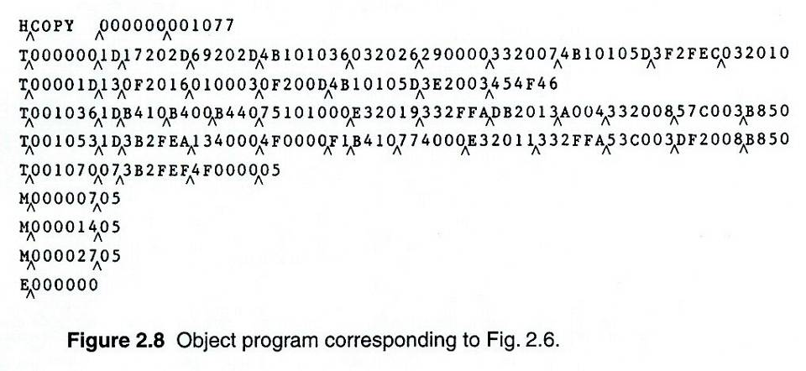
Object Code

Slide 21
Homework Assignment #5
Due Day : 23:59, December 22, 2003
SIC/XEAssembler
  In this homework, you are required to design an SIC/XE assembler. The input format of an SIC/XE assembly program is defined as follows:
    Columns 1 to 8 are the label field.
    Columns 11 to 18 are the opcode field.
    Columns 21 to 28 are the operand field.
  If a 4-byte instruction is used in a program, the ‘+” should be put on column 10. If the immediate (or indirect) addressing mode is used for an operand, the “#” (or “@”) should be put on column 20.
  Given an SIC/XE assembly program, the output of your assembler should include the memory location of each statement, the object code for each statement, the symbol table of the program, and the object program of the program.

